Slide 1

Capstone Project
Group-4

Slide 2


Dynamic Recrystallization in FSW of Brass: An effect of process parameters
Team Members
Neeraj Goyal (101608095)
Parukh Sharma (101608106)
Kushagar Chanana (101788013)
Kapil (101788030)
Manas Asija (101788031)
Project Supervisors
Prof. Ajay Batish
Dr. Dinesh W. Rathod

Slide 3
Literature Review
The joint properties of brass plates by friction stir welding Cemal Meran Mech. Engineering Dept., Engineering Faculty, Pamukkale University, 20020 Camlik, Denizli, Turkey | There are three factors that determine joint characteristics obtained by friction stir welding used definite pin surface geometry. These are pins rotation speed, pins welding speed and pins depth of sinking. Pins rotation speed and pins welding speed can be controlled easily. But, pins depth of sinking is so critical factor and difficult to be controlled. [1]
The effect of weld parameters on friction stir welding of brass plates G. C . Am, H. T. Serindag ̆ , A. C. Akan, S. Mistikoglu, H. Yavuz | Several difficulties are encountered in fusion welding of brasses with conventional joining processes are: Formation of weld surface irregularities. Change of colour due to oxidation. Insufficient penetration. Loss of strength at weld surface due to the formation of ZnO. Loss of strength in fusion zone due to the evaporation of Zn. Almost all of these problems are not expected to be encountered in friction stir welding, which is a solid state joining technique. [2]
Hardness and tensile behaviour of friction stir welded Cu-40wt%Zn brass N Srirangarajalu & A Rajadurai Madras Institute of Technology, Anna University, Chennai 600 044, India | In previous study various tool pin profiles were examined and it was found that only taper threaded tool pin profile gave a better weld, During welding, the weld tool was tilted at angle of 3 degree clockwise. The weld nugget of FSW samples were analyzed by polishing and etching with nitric acid and distilled water (with equal ratio) for nearly 3-4 s in the cross-section perpendicular to the welding direction. weld. [3]
Microstructural and Mechanical Characterization of Friction Stir Butt Joint Welded 63% Cu-37% Zn Brass Plate BY G. QAM, S. MISTIKOGLU, AND M. PAKDIL | In this study, the applicability of friction stir welding to 63% Cu-37% Zn brass plate has been investigated. The joint performance values were determined by conducting optical microscopy, micro hardness measurements, and mechanical testing (e.g., tensile and bend tests). The effects of the tool rotational speed and the welding speed on the joint performance were determined. The best joint performances were obtained at a rotational speed of 1400 rev/min with a welding speed of 80 mm/min. [4]

Slide 4
Literature Review
This research paper told us that FSW depends on the primary factors i.e. Diameter of the tool, RPM of the tool and the feed Rate. This helped us in choosing these 3 categories for our research paper.
This research paper helped us getting the knowledge of the defects produced in the conventional welding of the brass and how the solid state weld helps overcome these defects for the practical application of brass.
This research paper helped us getting the tool pin specifications as here it is mentioned that the tapered pin will cause much less vibrations and mechanical disturbances during the welding or the bead process than the conventional cylindrical pin.
This research paper told us about the etchant to be used for the microscopy. The rotational speeds and the diameter of the tool were mentioned here for getting the desired results.
Some other research papers consulted are-
Effect of rotation speed on the microstructure and mechanical properties of dissimilar friction stir-welded copper/brass metals
L. Zhou & W. L. Zhou & J. C. Feng & W. X. He & Y. X. Huang & S. S. Dong
Microstructure and Mechanical Characterization of Friction-Stir-Welded Dual-Phase Brass
R. Ramesh, I. Dinaharan, E.T. Akinlabi, and N. Murugan
Effects of Welding and rotational speeds on the Microstructure and Hardness of Friction Stir Welded Single-Phase Brass
Sajjad Emami • Tohid Saeid

Slide 5
Design of Experiments
Parameters to be considered for experiment:
RPM of the tool – Low-900, High -1400
Welding Speed – Low-40mm/min , High-80mm/min
Tool Diameter variation– Low-Ø12mm, High-Ø15mm
The parameters are selected from the literature review for the FSW on the brass plate from the research papers mentioned before.
We have 3 parameters and corresponding 2 levels of variation for each.
Therefore, there are 2x2x2 i.e. 8 test cases on which we will perform the bead on plate.

Slide 6
Preparation of Tool
Cutting of Billet
Preliminary hardness testing
CNC Machining
Quenching
Final hardness testing
Tool was cut to the length of 80mm length and 15mm diameter as per the literature review. If the tool would have been longer then it would have the greater moment on the tip and that would make the tool weaker.
Other tools to be made via same process.
Rockwell hardness testing was used for the finding the hardness of the specimen.
Quenching was done for hardening of the tool.

Slide 7
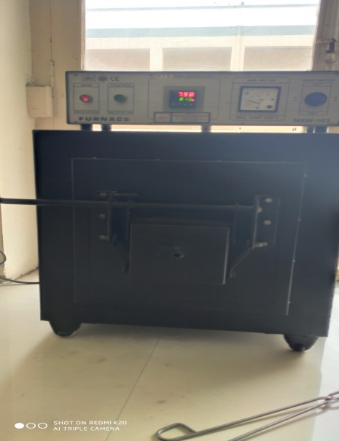
Quenching process
Quenching is the rapid cooling of a metal to adjust the mechanical properties of its original state. To perform the quenching process, a metal is heated to a temperature greater than that of normal conditions, typically somewhere above its recrystallization temperature but below its melting temperature.
For the Quenching process ASTM D3520-88(1998) were used based on the literature review of the research paper mentioned below. The standards tells us about the hardening temperature and time. [5]
Quenching Parameters
Hardening Temperature | 800 ֯C
Quenching Medium | Sunflower Oil
Time of heating | 75 minutes
Fig1 Quenching Process
(Pic. taken from Material Science Lab.)

Slide 8
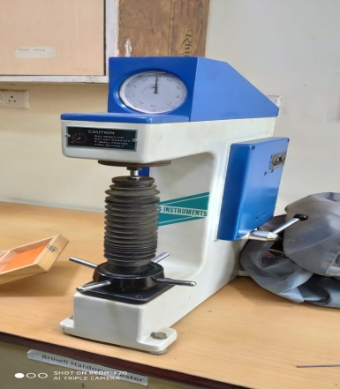
Continued.
Rockwell Hardness Testing
In this testing a verified machine is used to force a diamond spheroconical indenter under specified conditions into the surface of the material under the test. [6]
Preliminary hardness testing results of EN31. Rockwell hardness test was done before quenching, three observations were taken. ASTM A370 standards were used for the Rockwell hardness testing for the EN31.
And another three observations were taken after quenching
Fig 2 Rockwell hardness testing machine
(Image taken from Material Science Lab.)
Condition | (HRC-1) | (HRC-2) | (HRC-3) | Average
Unquenched | 54 | 57 | 56 | 55.67
Quenched | 64 | 63 | 65 | 64

Slide 9
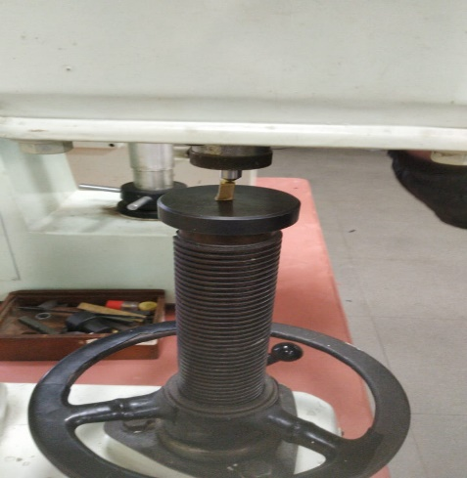
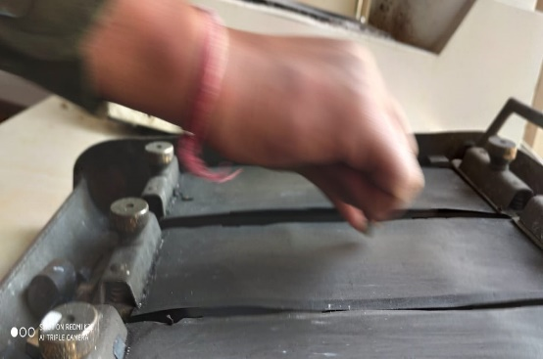
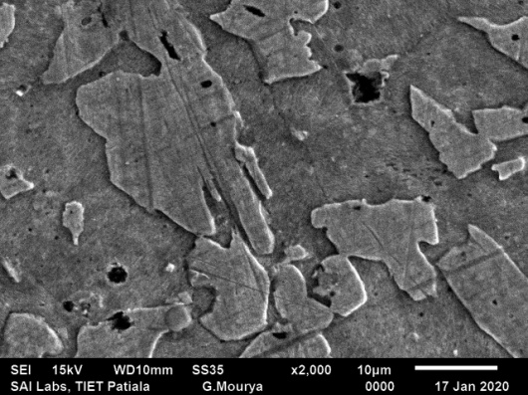
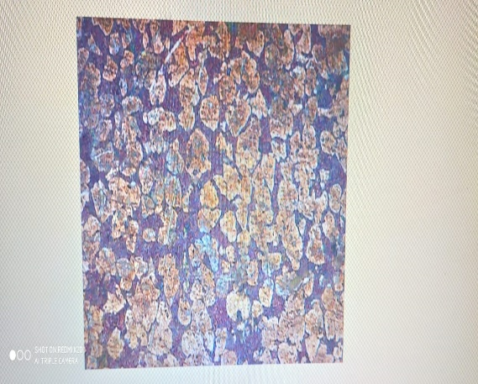
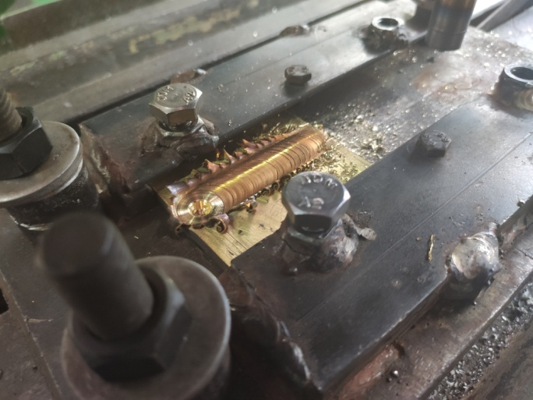
Preparation of Workpiece
Cutting of Work piece
Preliminary hardness testing
Polishing (Etching)
Viewing grains under optical microscope (100x)
SEM (Scanning Electron Microscope)
EDS (To identify composition)
Bead on Plate
Final Hardness Testing

Slide 10
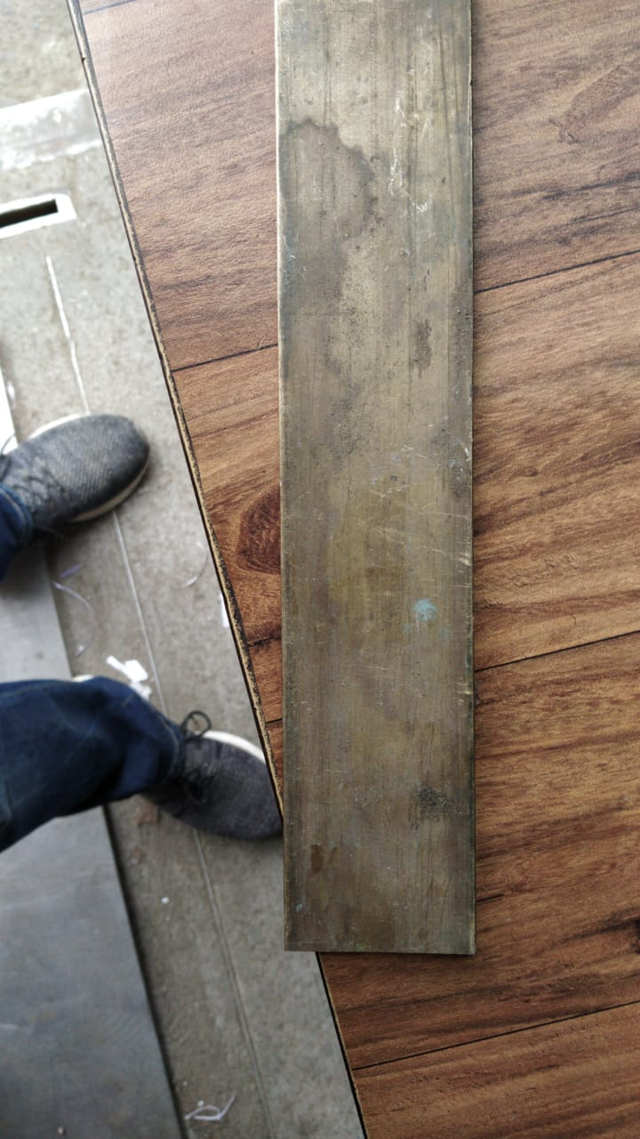
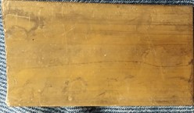
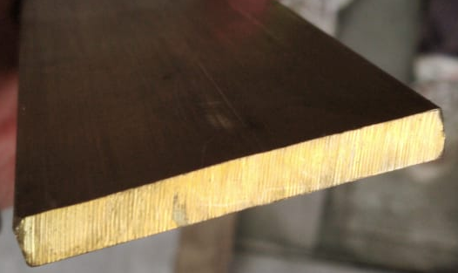
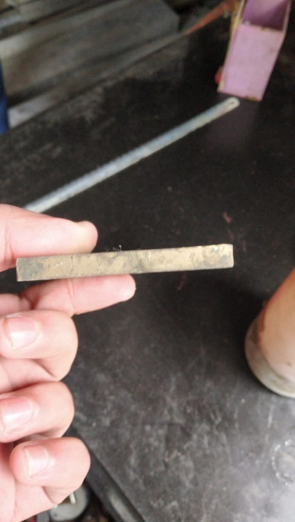


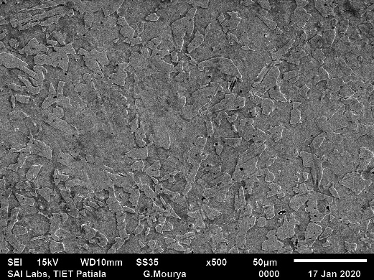
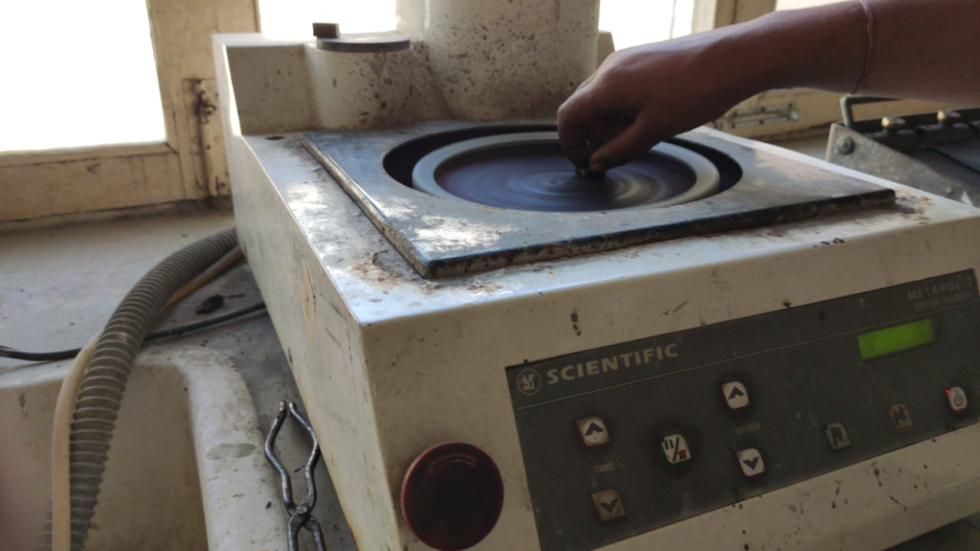
Tasks Accomplished
Task No. | Tasks | Details & Observations
1. | Brass sample procurement
2. | Material feasibility testing- Cutting Grinding Polishing Etching Microstructure using Optical Microscope & SEM
Sample-1
Sample-2
Sample-3
Sample-4
Grinding
SEM x2000
SEM x500
Polishing
Result- Equiaxed samples identified

Slide 11
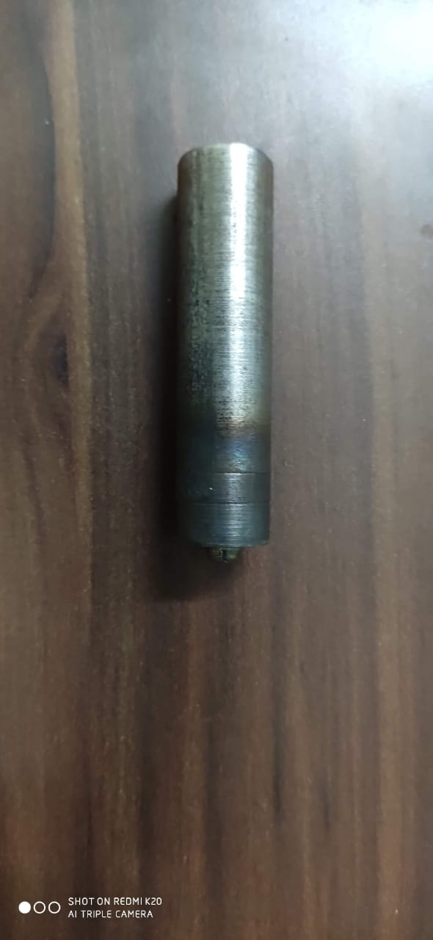
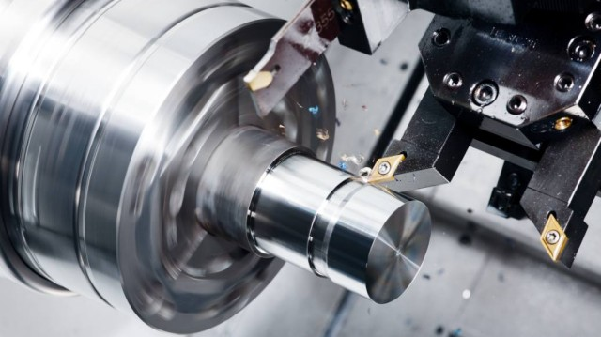
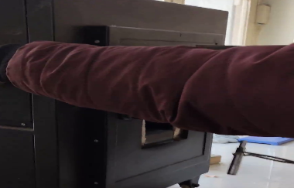
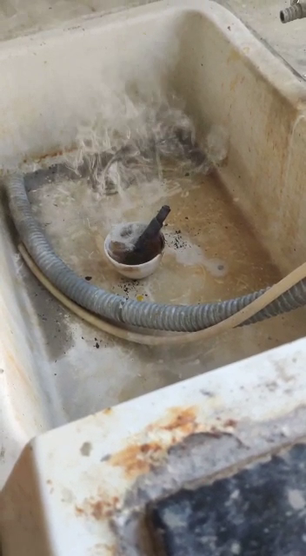
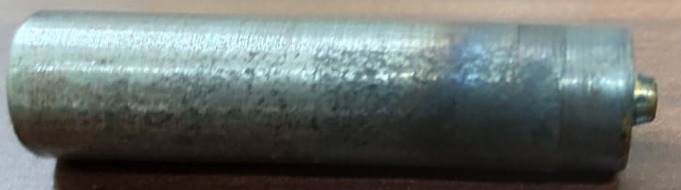
Tasks Accomplished
Task No. | Tasks | Details & Observations
3. | Tool material selection & procurement
4. | Tool Fabrication- Manual Cutting CNC Turning - Ø12mm & Ø15mm Quenching Hardness Testing
Dimensions – Ø20mm x 200mm
Result-EN-31 selected
CNC Turning
Heat Treatment @800C
Quenching
Final Tool

Slide 12
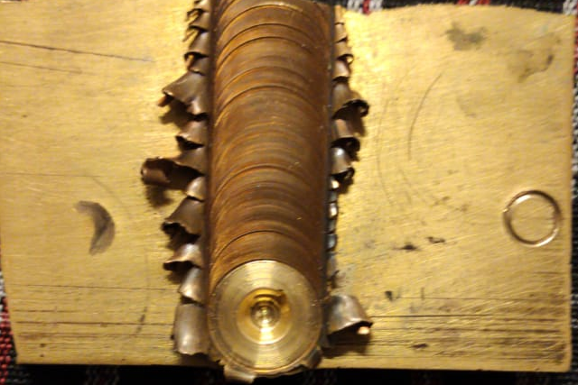
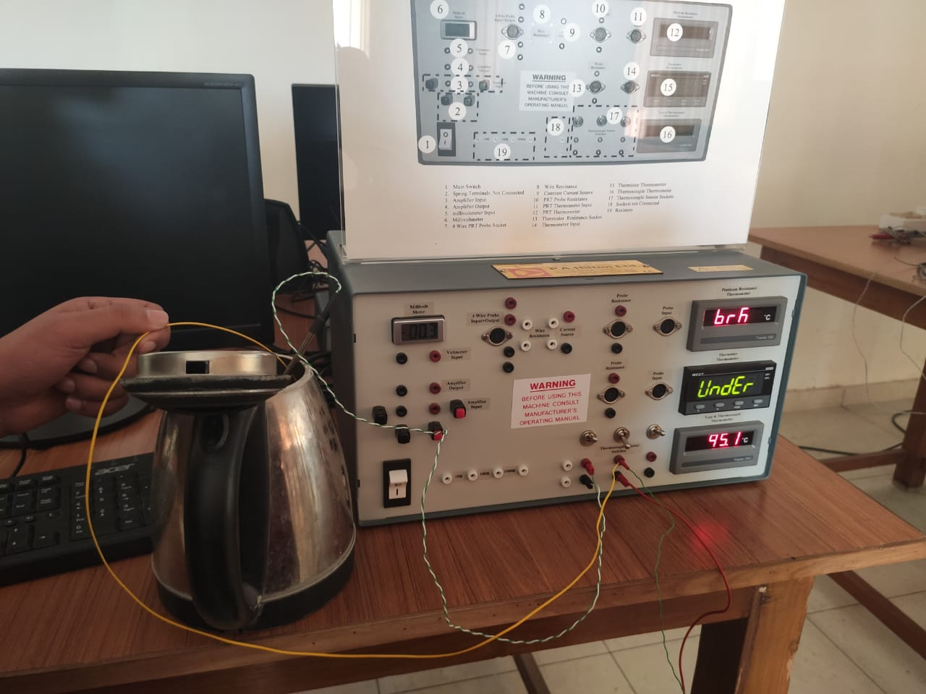
Tasks Accomplished
Task No. | Tasks | Details & Observations
5. | Trial Run to test feasibility of process
6. | Thermocouples preparation- Bead Formation Calibration
Parameters-
Tool Diameter – Ø15mm
Feed – 40mm
RPM – 900rpm
K-type Thermocouples were tested to measure the temperature of boiled water allowed to cool naturally and thermocouples found to show variation more than 1.5C from expected reading were defective.

Slide 13
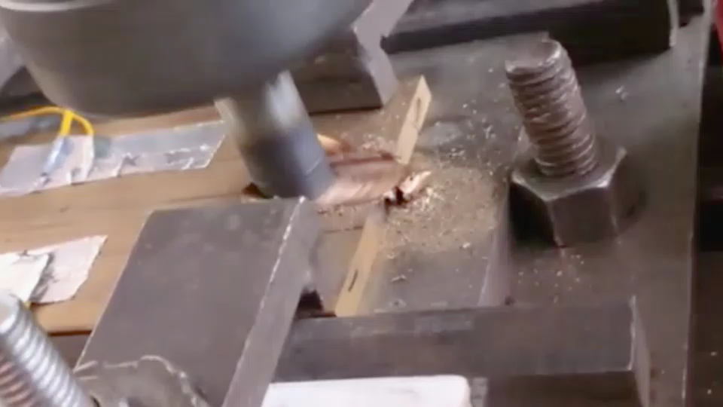
Tasks Accomplished
Task No. | Tasks | Details & Observations
7. | Beads on Plate with simultaneous Temperature monitoring
Parameters-
Tool Diameter - Ø15 & Ø12mm
Feed – 40 & 80mm
Rotational Speed- 900 & 1400 rpm
Process Representation

Slide 14
Beads on Plate Observations
Run No. | Parameters | Observations
1. | Tool Diameter – Ø15mm R.P.M. – 900rpm Feed - 40mm/min
2. | Tool Diameter – Ø15mm R.P.M. – 1400rpm Feed – 40mm/min
Peak Temp – 304.49 C
Peak Temp – 317.3375 C

Slide 15
Beads on Plate Observations
Run No. | Parameters | Observations
3. | Tool Diameter – Ø12mm R.P.M. – 1400rpm Feed - 40mm/min
4. | Tool Diameter – Ø12mm R.P.M. – 1400rpm Feed – 80mm/min
Peak Temp – 232.627 C
Peak Temp – 253.47 C

Slide 16
Beads on Plate Observations
Run No. | Parameters | Observations
5. | Tool Diameter – Ø15mm R.P.M. – 1400rpm Feed - 80mm/min
6. | Tool Diameter – Ø15mm R.P.M. – 900rpm Feed – 80mm/min
Peak Temp – 237.68 C
Peak Temp – 277.81 C

Slide 17
Beads on Plate Observations
Run No. | Parameters | Observations
7. | Tool Diameter – Ø12mm R.P.M. – 900rpm Feed - 80mm/min
8. | Tool Diameter – Ø12mm R.P.M. – 900rpm Feed – 40mm/min
Peak Temp – 215.09 C
Peak Temp – 328.76 C

Slide 18
Cost Feasibility
S.No. | Supplier | Type of Grains | Cost per Kg (in Rs) | Cutting Cost per plate (in Rs) | Availability
1 | Bombay Metals | Non Equiaxed | 410 | 20 | Same Day
2 | Hindustan Metals | Equiaxed | 450 | 20 | Same Day
3 | Ludhiana Metals | Equiaxed | 480 | 25 | Same Day
4 | New Metals | Equiaxed | 435 | Our self | After 7 days
Out of the 4 samples tested the cheapest one was found out to be non-equiaxed. So that needs to be rejected though it was the cheapest.
The 0ne with new metals was not available in time that's why we rejected it though it was cheaper than that at Hindustan Metals.
So we were left with 2 options i.e. Hindustan Metals and Ludhiana Metals and bought the cheaper one keeping in mind our budget constraints.

Slide 19
Tasks to be done
Approximate time required = 15 days
Cutting the 8 samples
Etching
Viewing grain structure under the optical microscope
Hardness Testing
Impact Testing
Tensile Testing

Slide 20
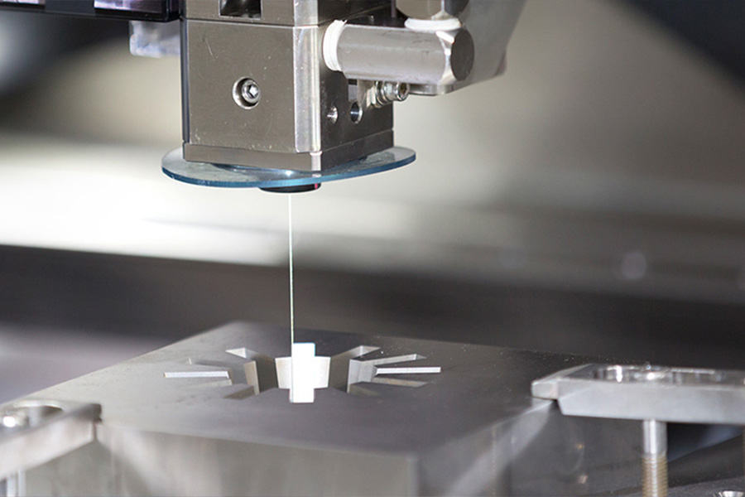
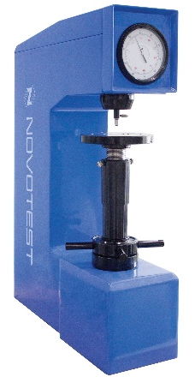
Tasks to be done
Sr. No. | Task | Details
1 | Cutting of samples
2. | Etching | The samples obtained after cutting need to be etched with appropriate etchants to get the enhance visibility of the grain structure. Etchant used- Ammonium Hydroxide (dilute solutions) Standard Used- ASTM E407
3. | Observation of changes to grain structure | The grain structure of all the 8 samples need to be observed to check the changes under various parametric conditions.
4. | Rockwell Hardness Testing
Wire Electrical Discharge Machining Cutting (E.D.M.) is required to be done for all the 8 samples.
Wire EDM was our preferred way of cutting of samples as it leaves very less debris and produces a very accurate line, though the cost is bit on the higher side.
Rockwell hardness testing needs to be done on all the samples to observe the variation of material after exposure to various parametric conditions from standard hardness of brass.
Standard Used- ASTM B36/36M

Slide 21
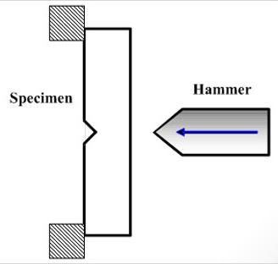
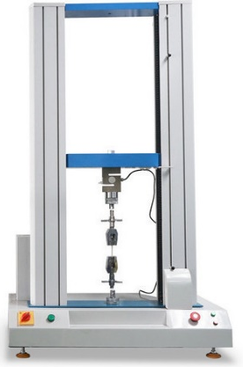
Tasks to be done
Sr. No. | Task | Details
5. | Notch Test with Charpy Impact Tester
6. | Tensile Testing
Notch Test with Charpy Impact tester needs to be done on all the samples to observe the variation of material after exposure to various parametric conditions from standard property of brass.
Standard Used- ASTM E23
Tensile testing needs to be done on all the samples to observe the variation of material after exposure to various parametric conditions from standard property of brass.
Standard Used- A370-07a

Slide 22
End result if we are unable to continue
Before the lockdown started, we were able to conduct 8 runs and gather the Temperature distribution data using thermocouples for each run. These temperatures were within the recrystallization temperature of brass.
If we are unable to continue, we will still be able to do the analysis of the data collected and show the correlations between the temperature distribution and the parameters we varied.
What we won’t be able to do is the analysis of the impact of bead on plate of brass on its hardness, tensile strength, impact strength and the grain structure.

Slide 23
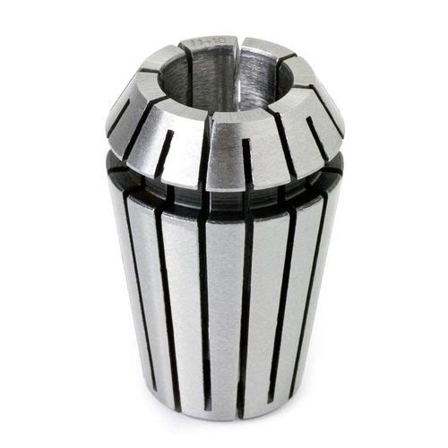
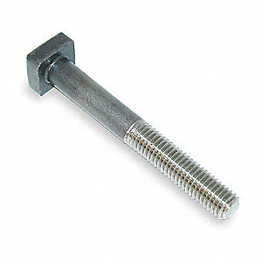
Challanges Faced
Sr. No. | Problem | Description
1 | Material & Cutting Equipment Availability | From collecting variety of samples to procurement of appropriate material, it has to be sourced from Ludhiana or Delhi.
2 | Tool Tip Tapering
3 | Collet Sizing unavailable | The Collet for holding the tool is not required as per the required dimensions.
4 | T-bolts not available | The nut couldn’t get into the space without threads. So spacer were made in the workshop. It halted the bidding process initially.

Slide 24
References
[1] The joint properties of brass plates by friction stir welding
Cemal Meran Mechanical Engineering Department, Engineering Faculty, Pamukkale University, 20020 Camlik, Denizli, Turkey
[2] The effect of weld parameters on friction stir welding of brass plates G. C ̧ am, H. T. Serindag ̆ , A. C ̧ akan,S. Mistikoglu, H. Yavuz
[3] Hardness and tensile behaviour of friction stir welded Cu-40wt%Zn brass
N Srirangarajalu & A Rajadurai Madras Institute of Technology, Anna University, Chennai 600 044, India
[4] Microstructural and Mechanical Characterization of Friction Stir Butt Joint
Welded 63% Cu-37% Zn Brass Plate BY G. QAM, S. MISTIKOGLU, AND M. PAKDIL
[5] P.Prasanna et.al, “Effect of tool pin profile and Heat Treatment process in the friction stir welding of AA6061, Volume no-27,01,2013
[6] ASTM E18 - 20 Standard Test Methods for Rockwell Hardness of Metallic Materials https://www.astm.org/Standards/E18.htm

Slide 25


